Slide 1

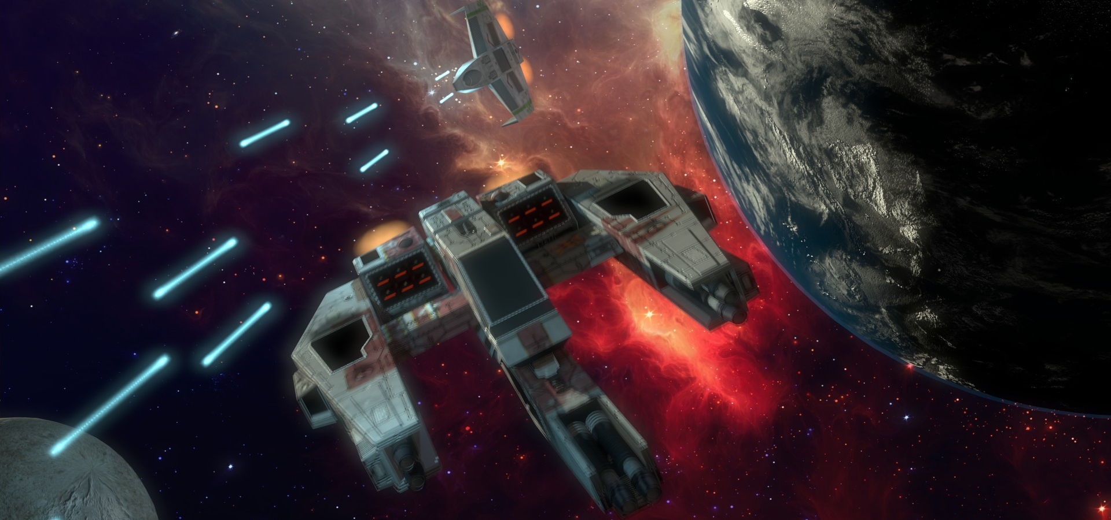
Pilots
Ships
Cannons
Missiles
Load Simulation

Slide 2
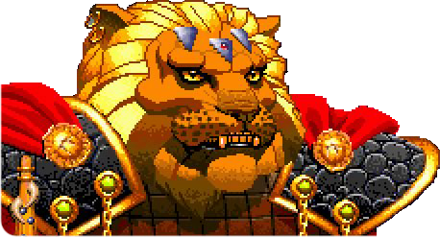
Pilots
Ships
Cannons
Missiles
Load Simulation
Load Confederation Pilots
Prince Thrakath nar Kiranka
Bakhtoh “Redclaw’ nar Kiranka
Bhurak “Starkiller” nar Sihkag
Dakhath nar Caxki
Khajja nar ‘Ja’Targk
Ja’Trosh “Long Fang” nar Caxkai
First Tooth
Primary Fang
Prince Thrakath nar Kiranka
Cost:
195
Pilot Skill
Gunnery Skill
Psych
Pilot Ability:
8
9
9
If Prince Thrakath is deployed, he is automatically the Wing Leader. If there is more then one wing, he automatically the Squadron Commander. His wing members do not test for stress if they are outnumbers at the beginning of the game. Thrakath himself may re-roll any failed gunnery tests he suffers. he may re-roll a single failed dodge test per game turn.

Slide 3

Pilots
Ships
Cannons
Missiles
Load Simulation
Load Confederation Pilots
Prince Thrakath nar Kiranka
Bakhtoh “Redclaw’ nar Kiranka
Bhurak “Starkiller” nar Sihkag
Dakhath nar Caxki
Khajja nar ‘Ja’Targk
Ja’Trosh “Long Fang” nar Caxkai
First Tooth
Primary Fang
Bakhtosh 'Redclaw' nar Kiranka
Cost:
210
Pilot Skill
Gunnery Skill
Psych
Pilot Ability:
8
9
9
Redclaw may re-roll any failed gunnery skill tests he suffers.

Slide 4
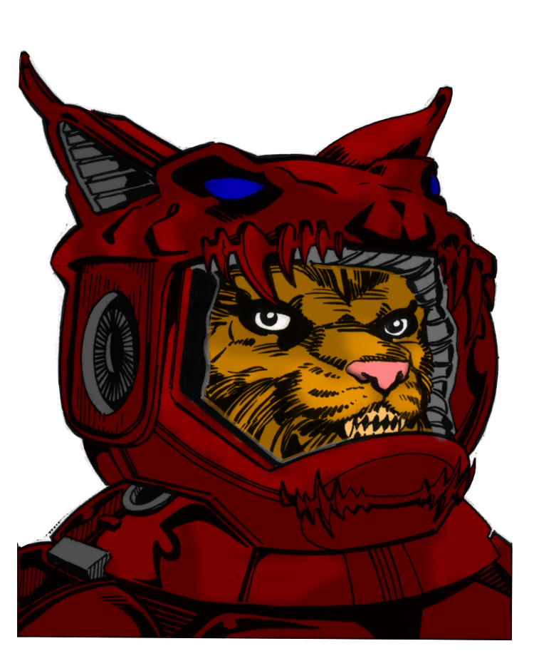
Pilots
Ships
Cannons
Missiles
Load Simulation
Load Confederation Pilots
Prince Thrakath nar Kiranka
Bakhtoh “Redclaw’ nar Kiranka
Bhurak “Starkiller” nar Sihkag
Dakhath nar Caxki
Khajja nar ‘Ja’Targk
Ja’Trosh “Long Fang” nar Caxkai
First Tooth
Primary Fang
Bhurak 'Starkiller' nar Caxki
Cost:
110
Pilot Skill
Gunnery Skill
Psych
Pilot Ability:
7
8
7
Bhurak dislikes using missiles, feeling that are beneath his skills. If he used a missile type weapon, and the attack is dodged, Bhurak must take a psych test. If he fails he gains 1 stress token.

Slide 5
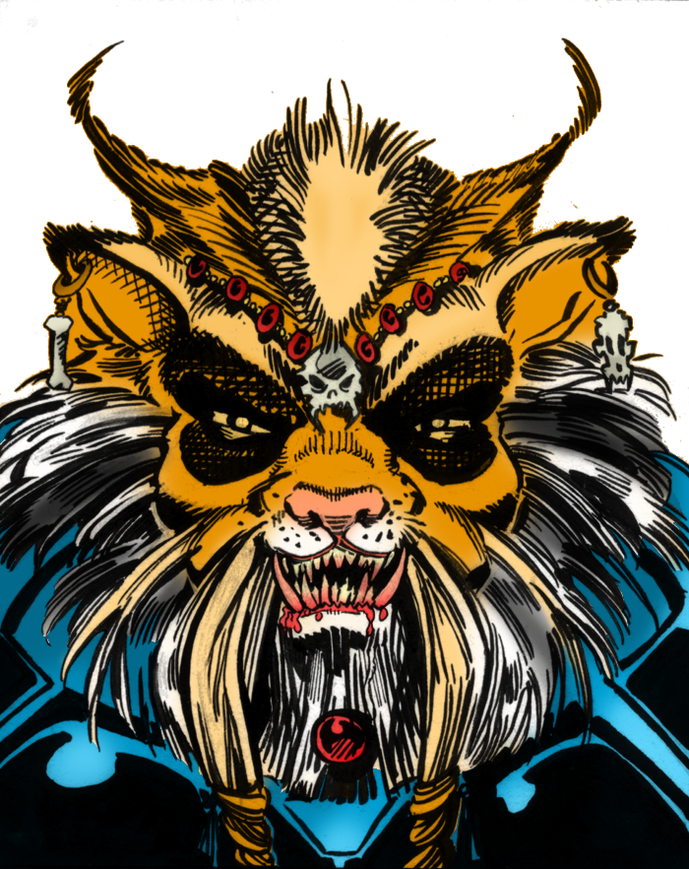
Pilots
Ships
Cannons
Missiles
Load Simulation
Load Confederation Pilots
Prince Thrakath nar Kiranka
Bakhtoh “Redclaw’ nar Kiranka
Bhurak “Starkiller” nar Sihkag
Dakhath nar Caxki
Khajja nar ‘Ja’Targk
Ja’Trosh “Long Fang” nar Caxkai
First Tooth
Primary Fang
Dakhat nar Sihkag
Cost:
125
Pilot Skill
Gunnery Skill
Psych
Pilot Ability:
7
8
7
Dakhath is exceptionally viscious but also loves a good dog fight. If he attempts to taunt an enemy pilot, count his psych stat as being 8. If Dakhath is the Wing Leader and his wing is outnumbers at the beginning of the game, his wing mates do not test to see if they are concerned. They are looking forward to a good fight.

Slide 6
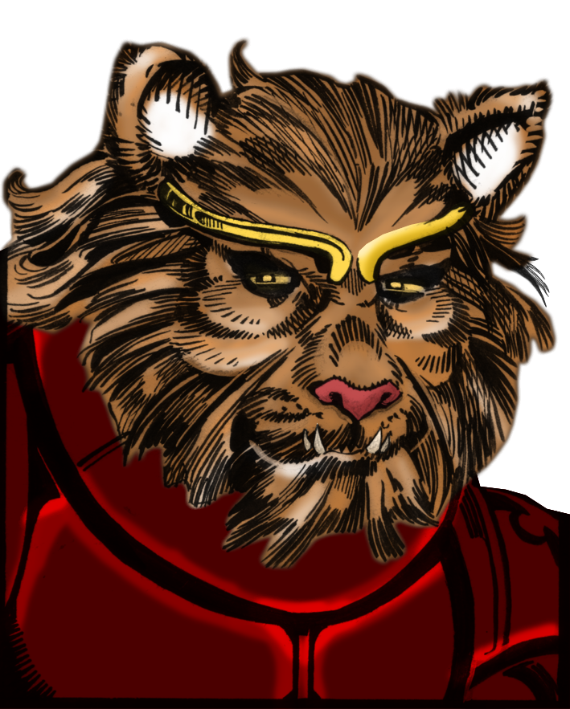
Pilots
Ships
Cannons
Missiles
Load Simulation
Load Confederation Pilots
Prince Thrakath nar Kiranka
Bakhtoh “Redclaw’ nar Kiranka
Bhurak “Starkiller” nar Sihkag
Dakhath nar Caxki
Khajja nar ‘Ja’Targk
Ja’Trosh “Long Fang” nar Caxkai
First Tooth
Primary Fang
Khajja nar Ja'targk
Cost:
230
Pilot Skill
Gunnery Skill
Psych
Pilot Ability:
8
8
7
Khajja is exceptionally single minded in his tactics. When testing to resist a taunt, treat his ego stat as being 8 rather then 5

Slide 7
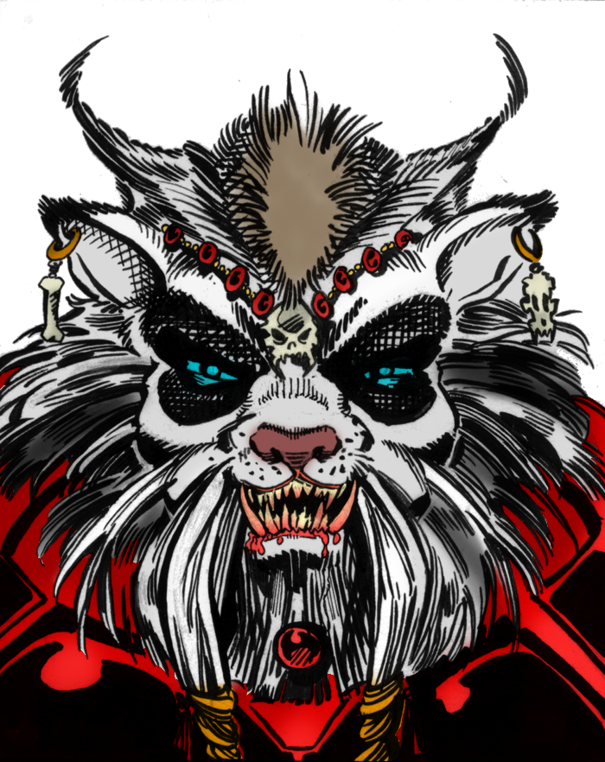
Pilots
Ships
Cannons
Missiles
Load Simulation
Load Confederation Pilots
Prince Thrakath nar Kiranka
Bakhtoh “Redclaw’ nar Kiranka
Bhurak “Starkiller” nar Sihkag
Dakhath nar Caxki
Khajja nar ‘Ja’Targk
Ja’Trosh “Long Fang” nar Caxkai
First Tooth
Primary Fang
Ja’Trosh ‘Lone Fang’ nar Caxkal
Cost:
195
Pilot Skill
Gunnery Skill
Psych
Pilot Ability:
8
9
9
Ja’Trosh is a loner by nature and prefers to fight on his own. He is unaffected by abilities that modify his psych stat, both enemy and friendly. He can re-roll failed pilot skill tests. If he is alone, count his Psych stat as 7 rather then 6.

Slide 8
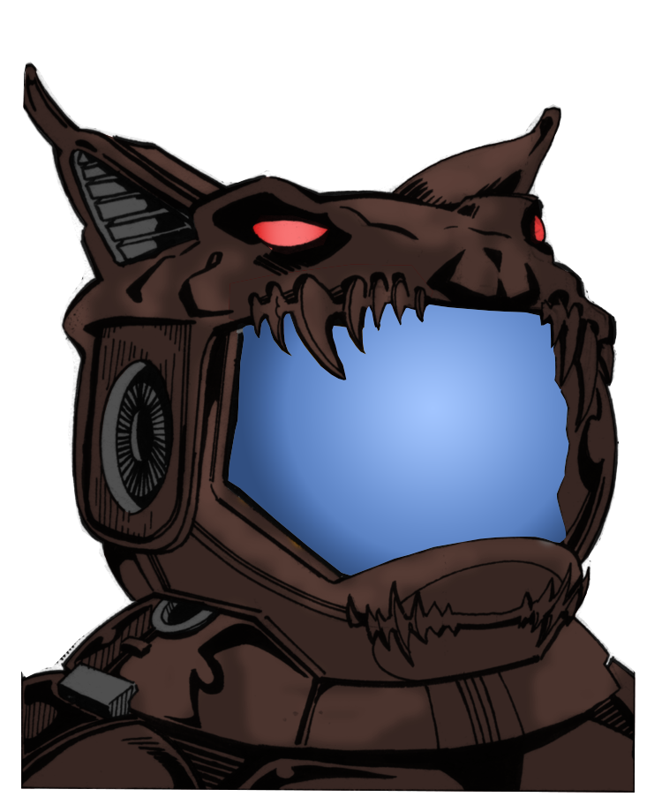
Pilots
Ships
Cannons
Missiles
Load Simulation
Load Confederation Pilots
Prince Thrakath nar Kiranka
Bakhtoh “Redclaw’ nar Kiranka
Bhurak “Starkiller” nar Sihkag
Dakhath nar Caxki
Khajja nar ‘Ja’Targk
Ja’Trosh “Long Fang” nar Caxkai
First Tooth
Primary Fang
Primary Fang
Cost:
195
Pilot Skill
Gunnery Skill
Psych
Pilot Ability:
8
9
9

Slide 9
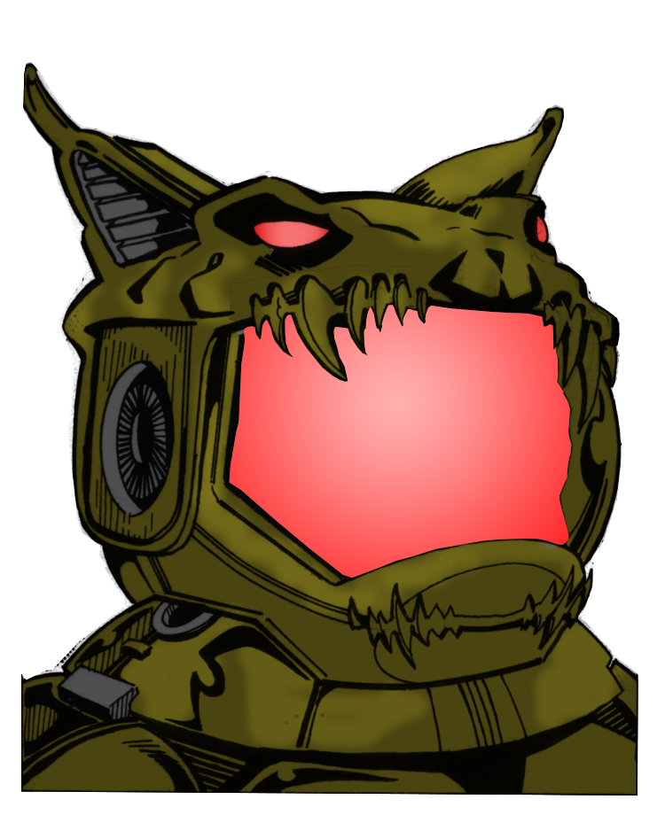
Pilots
Ships
Cannons
Missiles
Load Simulation
Load Confederation Pilots
Prince Thrakath nar Kiranka
Bakhtoh “Redclaw’ nar Kiranka
Bhurak “Starkiller” nar Sihkag
Dakhath nar Caxki
Khajja nar ‘Ja’Targk
Ja’Trosh “Long Fang” nar Caxkai
First Tooth
Primary Fang
First Tooth
Cost:
45
Pilot Skill
Gunnery Skill
Psych
Pilot Ability:
3
2
4

Slide 10
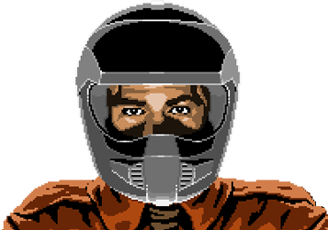
Pilots
Ships
Cannons
Missiles
Load Simulation
Load Kilrathi Pilots
Rookie Pilot Confederation Lieutenant
Seether
Troy 'Cathscratch' Carter
Winston 'Vagabond' Chang
Rookie Pilot
Cost:
45
Pilot Skill
Gunnery Skill
Psych
Pilot Ability:
3
2
4

Slide 11
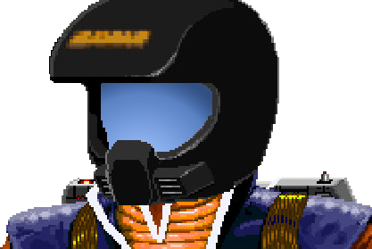
Pilots
Ships
Cannons
Missiles
Load Simulation
Load Kilrathi Pilots
Rookie Pilot Confederation Lieutenant
Seether
Troy 'Cathscratch' Carter
Winston 'Vagabond' Chang
Confederation Lieutenant
Cost:
65
Pilot Skill
Gunnery Skill
Psych
Pilot Ability:
5
3
5

Slide 12
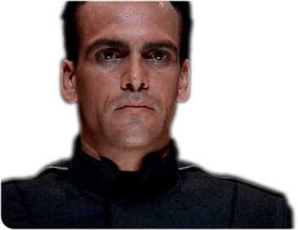
Pilots
Ships
Cannons
Missiles
Load Simulation
Load Kilrathi Pilots
Rookie Pilot Confederation Lieutenant
Seether
Troy 'Cathscratch' Carter
Winston 'Vagabond' Chang
Seether
Cost:
210
Pilot Skill
Gunnery Skill
Psych
Pilot Ability:
9
8
9
When he makes a dodge test, Seether only ever suffers a -1 to his pilot skill. He may re-roll a failed taunt and any failed gunnery skill tests he is called on to make.

Slide 13
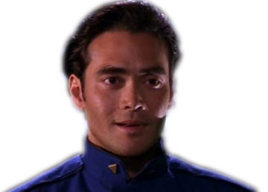
Pilots
Ships
Cannons
Missiles
Load Simulation
Load Kilrathi Pilots
Rookie Pilot Confederation Lieutenant
Seether
Troy 'Cathscratch' Carter
Winston 'Vagabond' Chang
Troy 'Cathscratch' Carter
Cost:
100
Pilot Skill
Gunnery Skill
Psych
Pilot Ability:
5
4
4
If Catscratch fails a Psych test, and the Wing leader/Commander is in his foward arc, he may re-roll the ego test but counts his Ego stat as being 5 rather then 4.

Slide 14
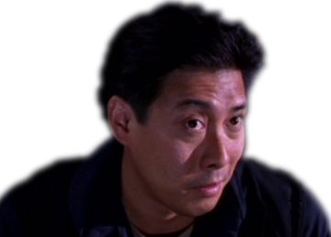
Pilots
Ships
Cannons
Missiles
Load Simulation
Load Kilrathi Pilots
Rookie Pilot Confederation Lieutenant
Seether
Troy 'Cathscratch' Carter
Winston 'Vagabond' Chang
Winston 'Vagabond' Chang
Cost:
190
Pilot Skill
Gunnery Skill
Psych
Pilot Ability:
5
7
7
If Winston Chang is the Wing Leader, all pilots in his wing may re-roll failed psych stat tests. If a friendly pilot with 1 or more stress tokens is with in his forward arc, Chang may attempt to calm them down. To do this he must sacrafice any attacks this turn and pass a psych test. If he succeds, the friendly pilot removes 1 stress token.

Slide 15
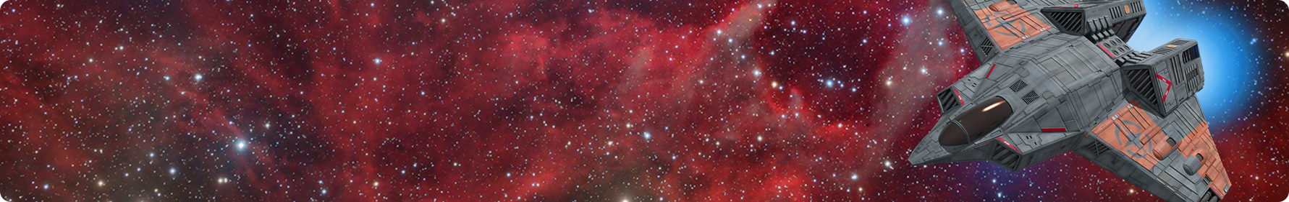
Pilots
Ships
Cannons
Missiles
Load Simulation
Load Kilrathi Ships
F-104 Bearcat
A-17A Broadsword
TB-76A Longbow
TB-80A Devastator
HF-66A Thunderbolt
FA-36A Hornet
F-109B Vampire F-107 Lance
F-103A Excalibur
F-86C HellCat
F-57B Sabre
B:
B
T:
B
S:
B
H:
B
E:
B

Slide 16
Pilots
Ships
Cannons
Missiles
Load Simulation

Slide 17
Pilots
Ships
Cannons
Missiles
Load Simulation

Slide 18
Pilots
Ships
Cannons
Missiles
Load Simulation

